Slide 1
Welcome!
⬇ please sign in
⬇ those of you who RSVPed, help yourself to a lunch
[re]fresh
fridays
introduce yourself to at least one colleague whom you
have not yet met
our students. who are they?
friday 09.09.16  12³⁰  145 PM  RM 36  355
facilitated by bonnie ripley  biology faculty + program review data liaison
sponsored by the offices of pd + equity and success

Slide 2
 to reinvigorate at the end of the week
[re]fresh
fridays
 to meet and talk with colleagues from across the campus
[and, thus, strengthen campus connections]
 to engage with provocative ideas and info
[and to spark your own reflections and insights]
 to – directly or indirectly – inspire and inform our individual and collective efforts in support of student success and equity

Slide 3
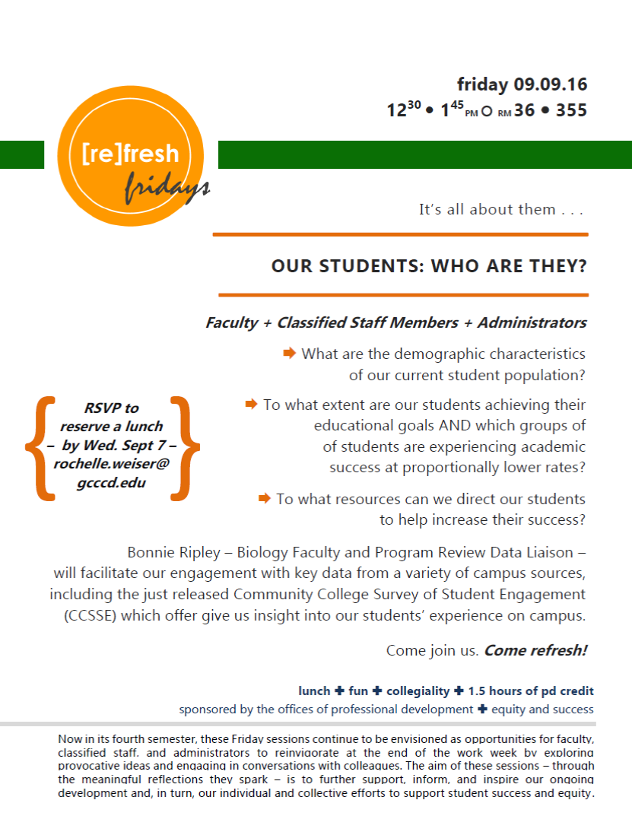

Slide 4
Data Sources
Colleague/District/RPIE Office/”Reports”
  Accesses student registration data and course history
  Used as “snapshot” data by semester
Student Success Scorecard 2015
  Uses 6-year cohort data
CCCCO Data Mart
  “snapshot” data by semester/academic year
Community College Survey of Student Engagement (CCSSE) Survey 2015
  Results coming soon to College Planning Web Site

Slide 5
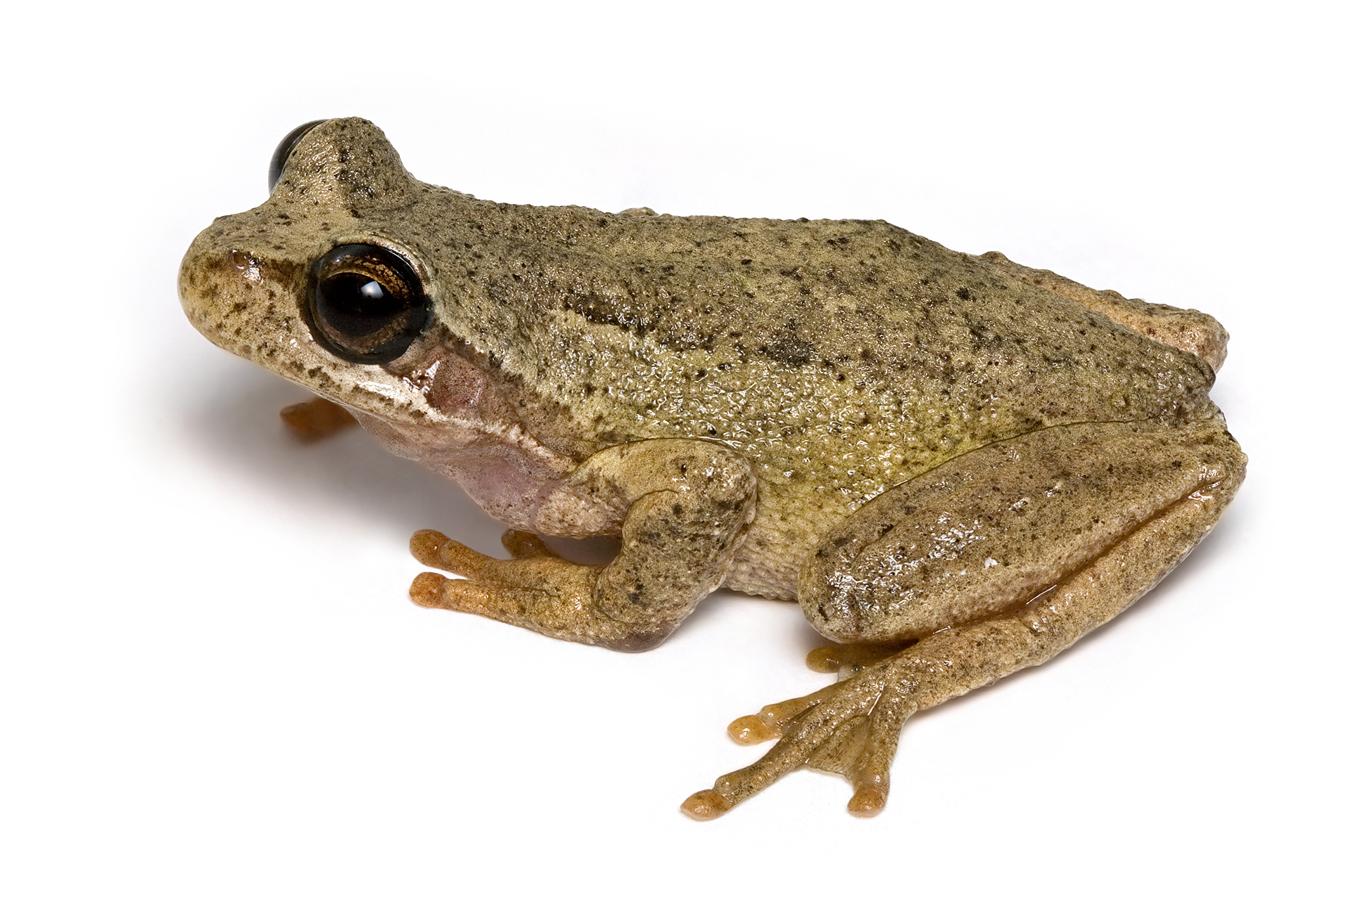
PART I: Demographic Data
What are the implications of this pattern for me as a college employee?

Slide 6
Think-Pair-Share
What were some of the characteristics of the “average “ student at the college you attended?
Notes:
Our students are not the same as the students I went to college with and not at all like I was as a college student

Slide 7
Notes:
Students in my classes have come from as far away as Tijuana and Murietta, many are outside our official “boundary”

Slide 8
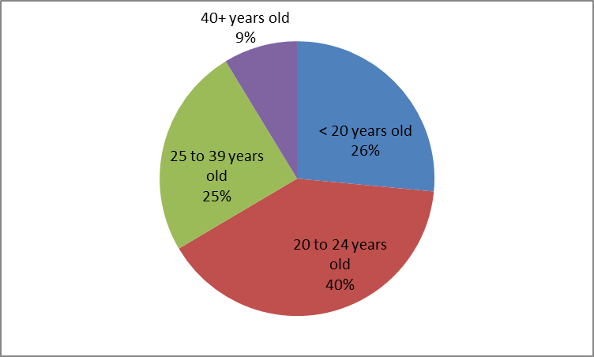
Grossmont Population by Age
*Much higher proportion of
younger people relative to service area
Notes:
47% of Boundary population over 40

Slide 9
Our students are Millenials!
The Good
  Technology savvy
  Socially connected/compassionate
  Entrepreneurial
  Progressive, practical and civic-minded
  Diverse and accepting
The Less Good
  Short attention span/low tolerance for delayed gratification
  Like to multi-task
  Poor at hierarchical thinking and prioritization
Notes:
Gen Y or millenials are born between 1980 and 2000

Slide 10
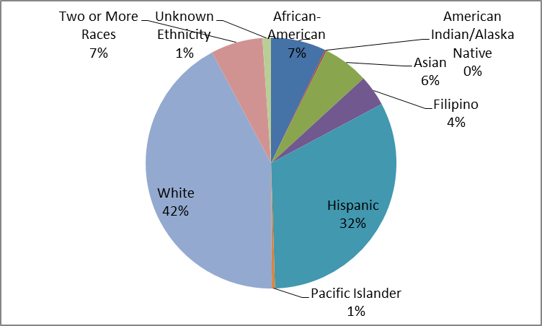
Grossmont Population by Ethnicity
CCCO Scorecard
Notes:
We are majority minority! AI/AN is 0.2% and PI is 0.4% Over past 5 yrs Latino incr. White decr. Others about same

Slide 11
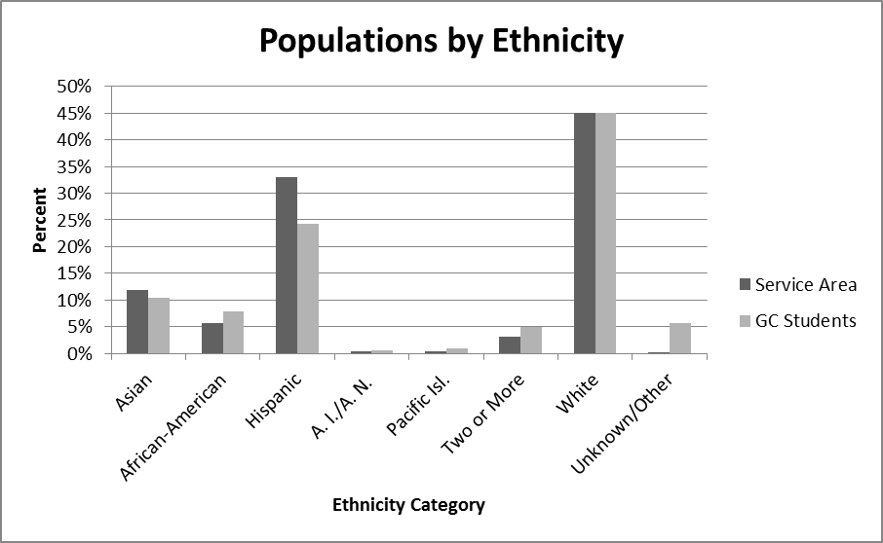
Grossmont 2014 Data Compared to Census 2010 Service Area
Notes:
Very similar comparison for this year; we are about as diverse as our service area, with fewer Hispanic students than expected, though. Our employees are another story—not as diverse as our service area.

Slide 12
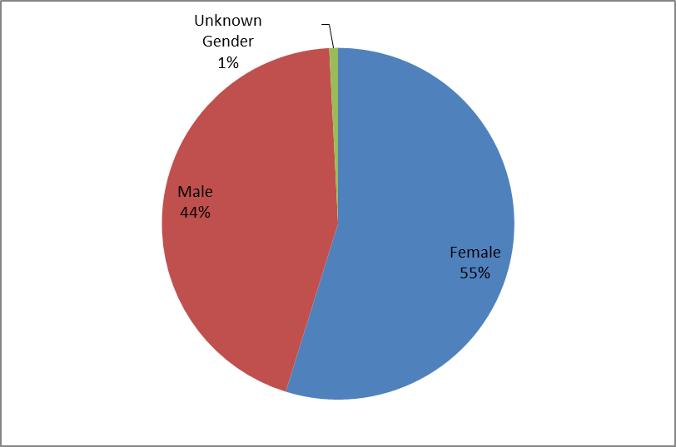
Grossmont Students by Gender
SD County 50:50
CCCO Scorecard
Notes:
Slightly less equal over last 5 years

Slide 13
Student’s Parents Education
 |  | Mother | Father
No college degree |  | 55.6% | 57.6%
College degree |  | 38.2% | 32.8%
Unknown |  | 6.2% | 9.6%
Probability (neither parent) = 0.32
Probability (both parents) = 0.13
When asked if they are 1st generation college
students, 30% say “yes”.
2015 CCSSE Student Results
Notes:
First-Generation Status
In 2012 CCSSE, 25% of student respondents indicated that neither parent has earned a degree higher than a high school diploma nor has college experience; in KPI report which comes from colleague, 30% report yes, numbers going up over time, but also “UK/not reported” has gone way down at the same time

Slide 14
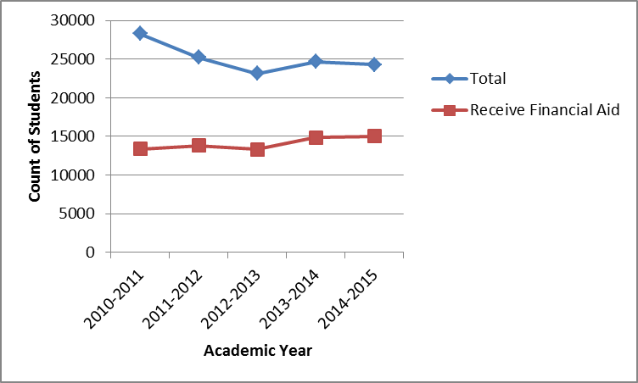
Students Receiving Financial Aid
CCCCO Data Mart
61.9%
Notes:
From CCSSE, 36.6% students rely primarily on Financial Aid to pay for college, or the rest about half pay for themselves and half have family support. Those on financial aid are counted as “economically disadvantaged”

Slide 15
Grossmont Students Citizenship Status
Notes:
From CCSSE, 70.8% ARE native English speakers; 10% 1-st time students take ESL placement test

Slide 16
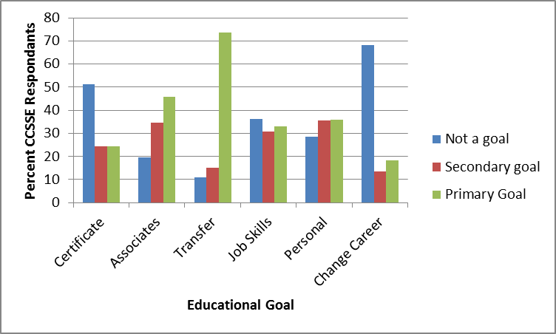
Student Educational Goals
2015 CCSSE Student Results

Slide 17
Other Special Populations
Immigrant/Refugee/International
  About 6% first-year students enroll in ESL courses
DSPS
  About 8% of students receive services
Veterans
  About 4% students receive GI bill benefits
Foster Youth
  About 0.5% students self-identified (< 100)
LGBT

Slide 18
Further Considerations…
Health conditions
In recovery
Formerly incarcerated
Single parents
Complex family situations
Homeless
Undocumented
Notes:
Open floor up for discussion here…make some concluding remarks: What is the “average” Grossmont College student? How are our students different from your peers when you were in college?

Slide 19
PART II: Student Success & Equity
Does it matter what “category” students are in?

Slide 20
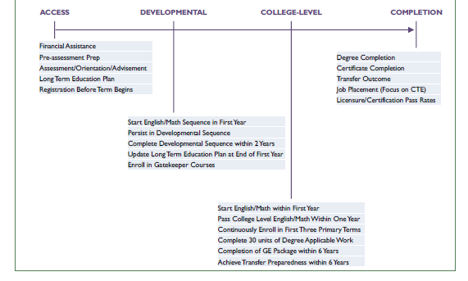
Notes:
Student Success Pathway Project “road map” for metrics we can track to see how students are moving from their first intention to enroll through successful achievement of their educational goal

Slide 21
Equity & Disproportionate Impact
Are students passing through each of these stages at the same rate depending on what demographic characteristics they have?
How do we assess this?
80% Rule
Proportionality Test
How do we summarize these results campus-wide?
Green—not impacted
Yellow—impacted on one of the two tests
Red—impacted on both tests
Notes:
80% is if the group is lower than 80% of the group with the highest success rate (not doing too much worse than the best group)
Proportionality is if the proportion in the starting group compared to the proportion in the ending group (does proportion drop going through gate)

Slide 22
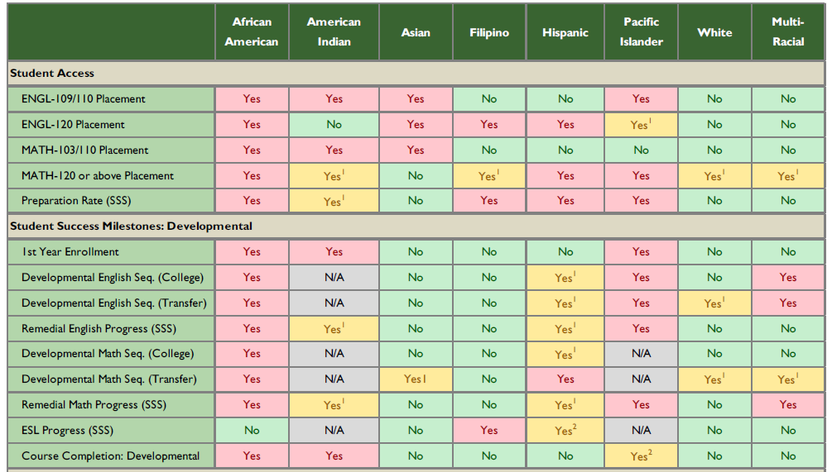
Equity “Heat Map”: Ethnicity

Slide 23

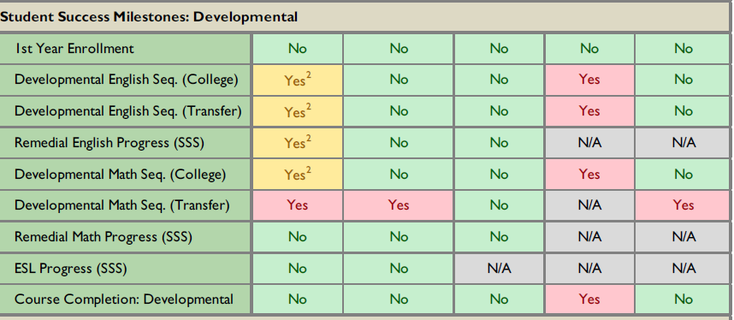
Equity “Heat Map”: Other

Slide 24
Think-Pair-Share
How do you feel about the equity outcomes on our campus?
What additional questions do you have?

Slide 25
PART III: Resources for Students
How can we help connect students to the resources they need?

Slide 26
Talking to Students
For example, Veterans
  In what branch did you serve?
  What was your job?
  Were you deployed? If so, where?
Any student
  Do you feel comfortable/safe/like you fit in on campus/in my classroom?
  How can I help you?
And what NOT to say…
  Diveristyinc.com: “Things NOT to say”
Notes:
We the college employees who are directly interacting with students have the most potential impact!
Open the floor up to general discussion of approaches and strategies, contributions from everyone.

Slide 27
Connecting Students to Resources
Hand out copies of Student Services sheet
Give students the name of a specific person to talk to in the office
Encourage students to use Grad Guru/apply for financial aid
Forward announcement about Dreamkeepers to all your students
Consider assigning something worth points that requires students to use the career center
Encourage students to work as tutors/TA, join sports teams, join clubs and ASGC
Notes:
However there are many other resources we can direct students to for further help, beyond what we are able to provide. Pass out SS sheet, plug the student services sessions.

Slide 28
What are your thoughts?
Wanna see more data???

